Slide 1
Forward kinematics
Scene graph
Quaternions

Slide 2
Child (or attached) meshes
We can move meshes together by setting all their model matrix parameters (position, orientation, scale) at the same time
Eg: The LEGO Spiderman model where all the parts are placed relative to the “model origin”. This is the same as the Power Plant mode, etc. – lots of models are like this
If they move, then we have to update ALL of the meshes at the same time.
This is tedious.

Slide 3
Child (or attached) meshes
Instead, we can add models to other models in a “graph” or “tree” where there are “parent” and “child” meshes.
The key here is that the model matrix of the “child” STARTS with the final model matric of the “parent“
If you move Spiderman’s hips, then all the other parts use that final matrix position as their starting point.
In other words, you DON’T move the child objects unless they are in a different location RELATIVE to the parent

Slide 4
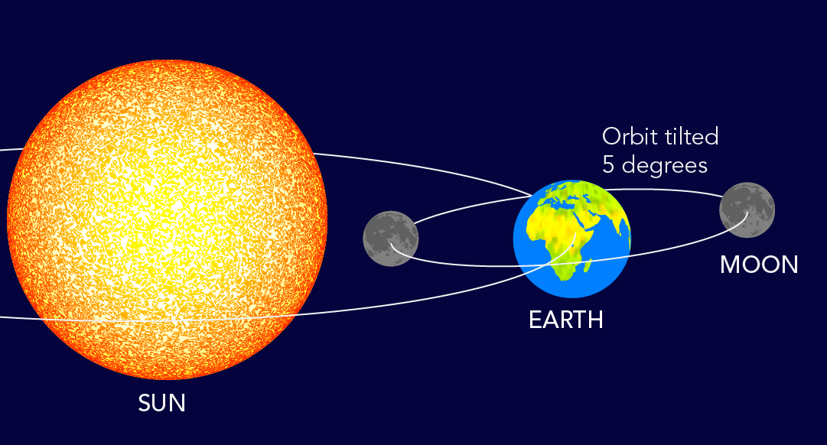

Slide 5
Handling relative position/rotation in a scene graph hierarchy of meshes
We need to keep track of a few things to handle relative motion/rotation, etc.
Where the object is relative to the “parent” object
i.e. a transformation that moves the object from its relative position with respect to the patent to a “local origin” of rotation that we desire
For example: We want to rotate Spiderman’s arm at the shoulder, but we need to figure out where that rotation axis is RELATIVE to the parent mesh

Slide 6
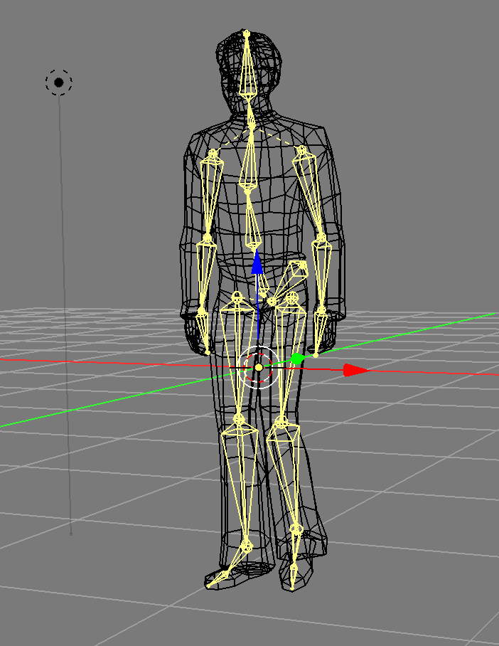
Forward kinematic
This is where we find a location of some end point based on the post or angle/whatever of a model
Basic idea is that while you traverse through the hierarchy of matrix values for the scene graph/bones, you keep track of the final matrix or location of the final object.
You may have to add another “bone”/transform to reach the actual point you want.

Slide 7
Inverse kinematics
This is sort of the opposite of FK (forward kinematics) but nightmarishly more difficult.
You are giving a final position of the end point (blue ball) and coming up with a plausible angle of ALL the joints/bones for the.
…and there are literally infinite possible poses for that.

Slide 8
Quaternion angle representation
We’ve been using Euler angles
Rotation around x and y and z
Potential issue is that are transformations are rotating the WORLD, so when we apply a rotation that’s large, worst case 90 degrees, 180 degree, we effectively “lose” one axis
Quaternions can be treated like matrix values.
Consider: you don’t store translation, rotation, and scale separately, instead you store them all together in a single mat4.

Slide 9
Hypothetical using mat4 instead of translation
Up to now:
Store position as a vec3 (xyz)
Now we store it as a mat4
“You place the object at 4, -17, 0”
Create a matrix that translated to (4, -17, 0)
mat4 matTrans = translate( 4, -17, 0 );
At the render call, you’d apply this matrix not the xyz
matModel *= matTrans

Slide 10
Hypothetical using mat4 instead of translation
Now consider you are moving it “a little bit”
Press a key and it moves (0, +0.1, 0)
(+0.1 units in the y)
vec3 adjustmentXYZ = vec3(0, +0.1, 0)
If you are storing position, you would add this to the current position:
PositionXYZ += adjustmentXYZ
Then use current position to calculate a model matrix
matModel = translate( Position)

Slide 11
Hypothetical using mat4 instead of translation
Now consider you are moving it “a little bit”
Press a key and it moves (0, +0.1, 0)
(+0.1 units in the y)
vec3 adjustmentXYZ = vec3(0, +0.1, 0)
matAdjustmentXYZ = translate( vec3( 0, +0.1, 0 ) );
Instead of adjusting the vec3 position:
PositionXYZ += adjustmentXYZ
matModel = translate( Position)
You apply this directly to the model matrix:
matModel *= matAdjustmentXYZ

Slide 12
Hypothetical using mat4 instead of translation
matAdjustmentXYZ = translate( vec3( 0, +0.1, 0 ) );
matModel = mat4(1.0f); // At the origin (0,0,0)
matModel *= matAdjustmentXYZ → now at 0, 0.1, 0
matModel *= matAdjustmentXYZ → now at 0, 0.2, 0
matModel *= matAdjustmentXYZ → now at 0, 0.3, 0
matModel *= matAdjustmentXYZ → now at 0, 0.4, 0
matModel *= matAdjustmentXYZ → now at 0, 0.5, 0

Slide 13
Quaternions are handled the same way
You don’t store the Euler angles
Vec3 myRotation = vec3( rX, rY, rZ )
You create a quaternion (just like with the matrix)
glm::quat qRotation45Y = glm::quat( vec3( 0.0, 45.0, 0.0 ) )
Just like the matrix, you don’t mess around with the values inside the matrix directly. Instead you apply (i.e. multiply) another matrix that updates or adjust

Slide 14
Quaternions are handled the same way
Like matrices, there is a type of “identity” quaternion
glm::quat qOrientation = glm::quat(1.0f)
Adjust this, say -37 degrees in the z:
glm::quat qAdjustment = glm::quat( vec3(0.0, 0.0, -37.0f) );
Updating the quaternion through multiplication:
qOrientation *= qAdjustment

Slide 15
Quaternions are handled the same way
glm::quat qOrientation = glm::quat(1.0f) // Euler 0, 0, 0
Adjust this, say -1 degrees in the z:
glm::quat qAdjustment = glm::quat( vec3(0.0, 0.0, -1.0f) );
Updating the quaternion through multiplication:
qOrientation *= qAdjustment → -1 degrees around z
qOrientation *= qAdjustment → -2 degrees around z
qOrientation *= qAdjustment → -3 degrees around z

Slide 16
Quaternions: WARNING!
There are 4 numbers in the quaternion, but beware because they are NOT x, y, z, w values.
You might be tempted to just change the 1st 2nd 3rd values, but they are NOT Euler angles.
Like a matrix, you don’t go in and touch the values inside.
You can get back the Euler angles, but be careful because like any rotation, there are an infinite number of rotations that match:
+90 is the same as -270 and all the other combination

Slide 17

Quaternions: WARNING!
The quaternion stores the rotation as an angle around a particular axis, not as Euler 3 axis things.
Any rotation can be represented like this
The easiest analogy is a globe:

Slide 18
Quaternions and matrices
glm::mat4 matRotateX =
glm::rotate(glm::mat4(1.0f),
glm::radians(pCurMesh->rotationEulerXYZ.x), // Angle in radians
glm::vec3(1.0f, 0.0, 0.0f));
glm::quat qRotation = glm::quat(glm::vec3(0.0f, 15.0f, 0.0f));
// Make matrix 15 degrees around y
glm::mat4 matRotation = glm::mat4(qRotation);
// Rotate it 15 degrees around Y FROM WHERE IS WAS
matRotation *= glm::mat4(qRotation);
// now matRotation is 30 degrees around the Y

